Slide 1
Strategic Advisory Board

Slide 2
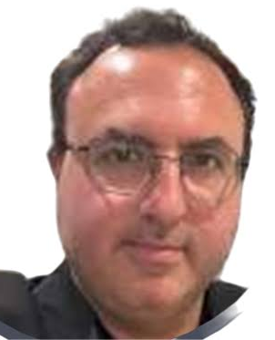
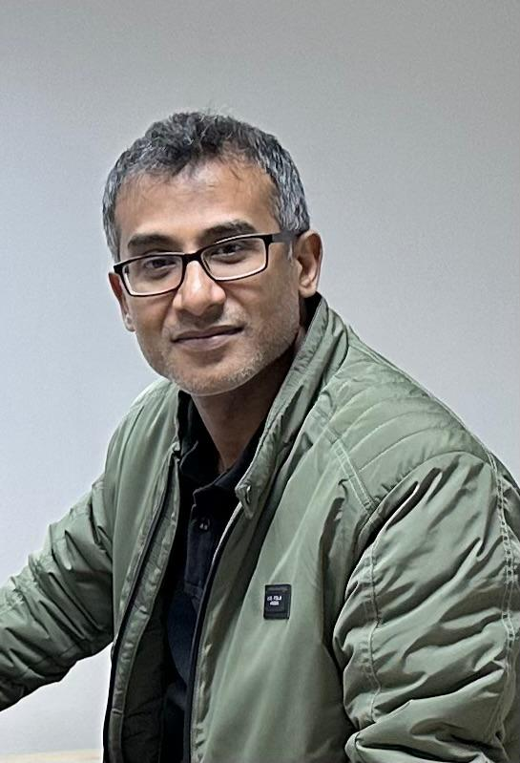

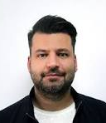
Alex Sullivan Esq.
Legal & Compliance
A corporate lawyer bbby profession, Alex handles and guides EGL with all legal and fiduciary matters.
Alex is a project advisory specialist for financial control & audit as well.
His company, BFL Law is based in the UK but has presence in the US and EU as well
Faisal Sarker
Technology
Faisal is a veteran software and technology expert having almost 25 years of experience.
He has worked with numerous projects globally including World bank certified projects, multi-national entities and government.
He is based in Bangladesh.
Fumiko Kamioka
Structured Finance
A former senior banker with experience in Japan, Singapore and Vietnamese markets.
Fumiko have been involved in project finance, strategic guidance and fund management processes at EGL.
She is currently based in Singapore.
Emre Aytekin
Project Partnership
Emre is a key Advisor for global networking for us.
He is also supporting us for international collaboration for financing and project management services.
He is an expert on project financing and institutional collaborations as well including donor cycles and consulting.
Emre is based out of Turkey.

Slide 3

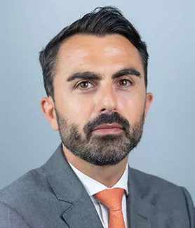
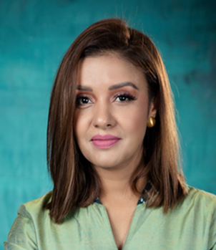
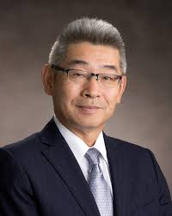
Patricia Issa
Business Development
A global networker, Patricia is our key Advisor for business development for sourcing projects and financing.
Patricia is a global networker and business specialist.
She is based out of Italy & Lebanon.
Roberto Mangano
Technical Advisory
As a senior engineer, Roberto has worked with globally acclaimed EPC giants like ILF consulting.
He has handled many top projects in the UAE, Africa and EU markets- with a deep focus in infrastructure development.
Roberto is currently based in the UAE.
Sayma Rahman
Venture Mentorship
Sayma is a strategic expert and a pioneering figure in her market as an Angel investor, she has worked with many seed to growth stage ventures in guiding them to success.
She ran her own entity SR Consulting focusing in the same areas.
She is currently based in Australia.
Peter Koh
Government Relations
Peter is a former diplomat, entrepreneur and key Advisor for global networking at EGL.
Peter has his own company called Cord Engineering in the line of projects and guides us for global international collaboration for government backed organizations.
Peter is based in Singapore.

